Slide 1

Using and promoting psychological strategies to support children and parents who are anxious about hospital
Dr Janie Donnan
Consultant Clinical Psychologist, Royal Hospital for Children, NHS Greater Glasgow and Clyde and
Programme Director, Paediatric Psychology, NHS Education for Scotland

Slide 2
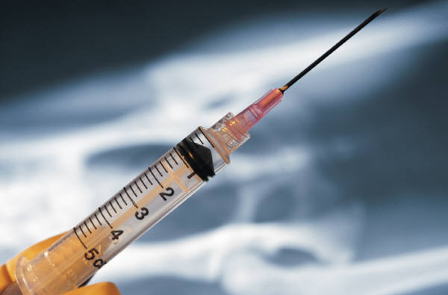
Show of hands!
Needle phobia – fact or fiction?

Slide 3
The reality
for most children, at least initially, medical procedures are an unpleasant experience and can result in considerable psychological distress for them and their parents/carers (including staff)
early experience of procedures important for future anxiety / engagement / co-operation
experiencing medical fear as a child is predictive of avoidance of medical situations as an adult, thus early intervention important (Roberts & Steele, 2009)
Preparing a child for procedures can be time consuming for medical professionals, as can treating emergent procedural anxieties and other psychological problems e.g. psychological trauma.
Maintaining the psychological well-being of children is a key component of child-centred treatment, and is associated with better adjustment and health outcomes (Edwards & Titman, 2010; GIRFEC)

Slide 4
Procedural Distress: What works?
Strong support for distraction, relaxation, hypnosis and cognitive behavioural approaches for reducing pain and distress (needle related procedures) (e.g NES Matrix 2013; Gaskell et al, 2009; Uman et al 2013)
Educating clinicians, parents and children (3 years+) about pain management interventions reduces distress and fear surrounding procedure, and reduces fear (vaccinations) (Pillia-Riddell et al 2011)
parental presence increases use of pain management strategies, distress and fear (Pillai-Riddell et al 2011)
More research needed in other areas e.g parent positioning plus distraction, blowing out air, and distraction plus suggestion (Uman et al, 2013)

Slide 5
Procedural Distress and Anxious Children
Trait-anxious children have a tendency to recall events as more painful than they were (Rocha et al 2009).
Anticipatory state anxiety is negatively associated with the success of procedural sedation (Schreiber et al 2005)
Children with chronic conditions can be more susceptible to this feedback loop resulting from increased exposure to painful procedures (but experience important).
Anxiety reduction is therefore particularly important for children with chronic conditions and/or trait anxiety.

Slide 6
Procedural Distress and Parental Support
Parental expectancies of procedure-related pain reliably predict child’s procedure-related pain (Liossi et al 2007)
Parental behaviour during pre-school immunization accounted for 53% of the variance in child distress (Frank et al., 1995, as cited in Roberts & Steele, 2009).
Training parents/carers to support their child using distraction increases child coping and reduces distress (Blount et al 1994)
Targeting parent/carers’ own pre-procedural anxiety might be beneficial to the parents as well as the children undergoing a distressing medical procedure (Bearsden et al 2012).
Parents/carers have a key role in supporting their child beyond the treatment room e.g. preparation and post-procedural activities (Blount et al 2003). Need to be given the right information and support to be able to do this
Parents adjusting to a child’s diagnosis report higher levels of anxious symptoms (Edwards & Titman, 2010), increasing the likelihood of social learning of anxious behaviour.

Slide 7
Procedural Distress and Choice/Control
National policy stipulates the need to provide appropriate support to children with potentially distressing procedures and involve them in a developmentally appropriate manner to facilitate participation in decisions around their own healthcare (e.g. GIRFEC 2009, NHS Quality Strategy 2010; NSF 2009).
Children actively involved in decision making are less anxious undergoing operations and treatment (Coyne, 2006).
Important to ensure children are facilitated to choose and utilize strategies they have chosen for themselves rather than having strategies imposed on them (e.g. Zimmer-Gembeck & Skinner, 2011; Kliewer, 1991)
Evidence suggests that children want to participate in decision making, however attempts to do so are often overlooked or overruled by medical professionals and parents (Coyne, 2008; Moore & Kirk, 2010

Slide 8
Warning Bells!
Excessive or ongoing distress / anxiety e.g refusal to go to clinic/hospital; build up of anxiety well before appointment; taking a long time to settle after a procedure – distress progressively getting worse
Children and young people do not always show distress in obvious ways e.g. crying or talking about it but will show it in other ways
Behaviour is always a form of communication
Other possible signs:
  Regression of behaviour (e.g. bedwetting, clingy)
  Tantrums or cheeky out with norm for age / personality
  Withdrawn
  Changes to sleep and eating
  Concentration problems
Consider onward referral (Play Specialist / Paediatric Psychology)

Slide 9
So what does that tell us?
Need to increase knowledge about psychological strategies for managing procedural distress and pain to children (3 years+), parents/carers and staff particularly distraction and relaxation e.g breathing techniques.
Remember importance of early experiences.
Need to improve preparation and information given to children, parents and carers.
Need to help children feel they have more control and more choice
Awareness of those more at risk e.g trait anxious children and/or children with chronic health condition; parents with anxiety / procedural anxiety
Need to recognise the importance of parents/carers in supporting their children (facilitate)
Ensure appropriate support given to parents/carers especially those with pre-existing anxiety and/or procedural anxiety and recognition of heightened anxiety of parents/carers whose children have just been diagnosed.
Recognise that whilst anxiety about procedures is normal, excessive distress is not normal – refer on to Play Specialists before anxieties become more entrenched

Slide 10
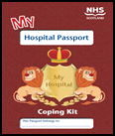

The Challenge
In spite of the evidence base and guidance, children and their parents/carers still often do not routinely receive developmentally appropriate or timely information around psychological strategies to support and reduce distress
no compulsory training around such issues for frontline clinical staff who struggle to be released for CPD events were they could develop such skills
Lack of availability of easily accessible information for children, parents/carers

Slide 11
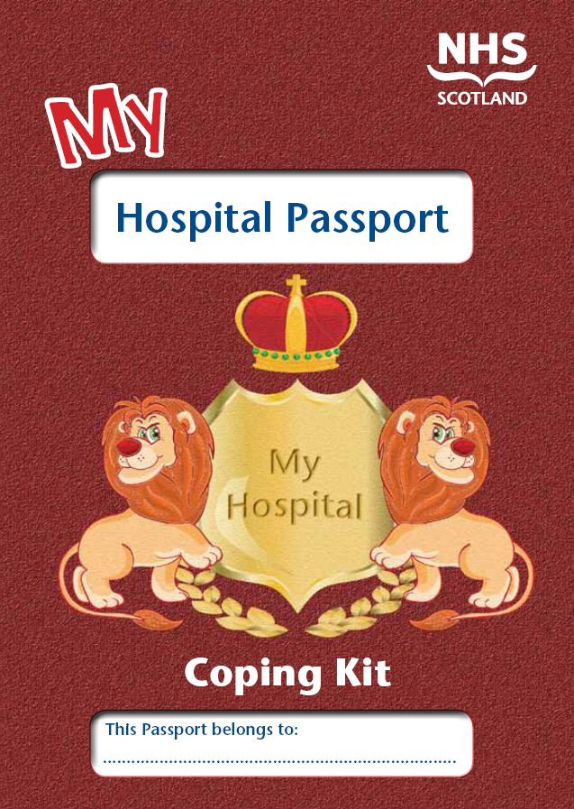
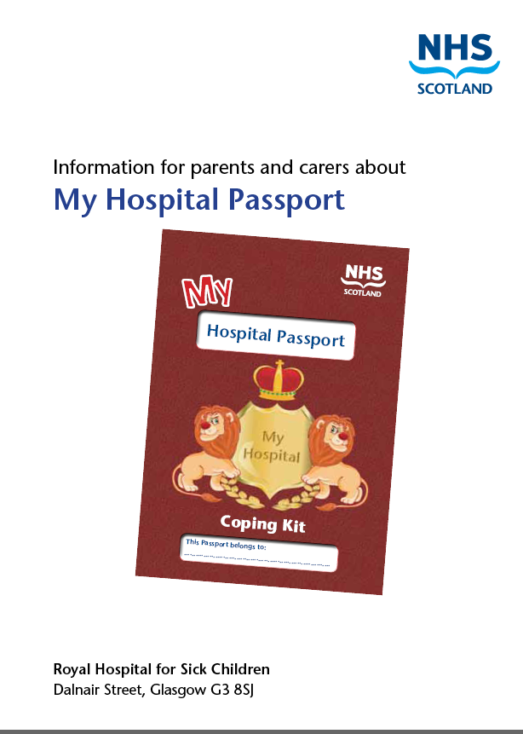

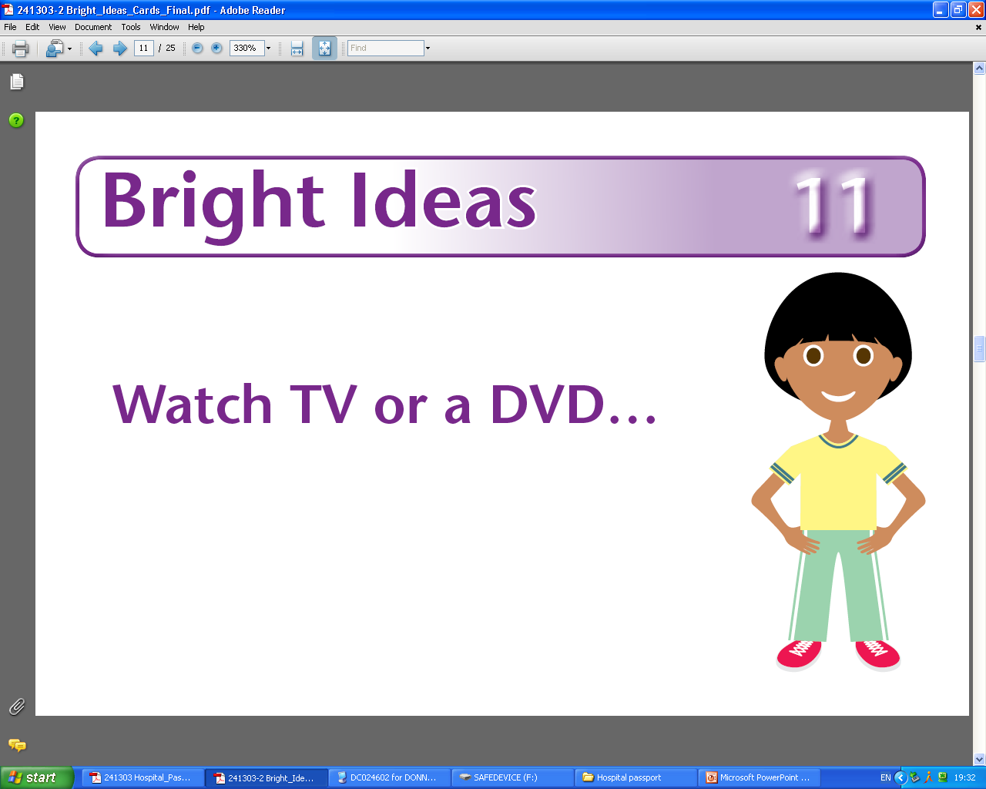
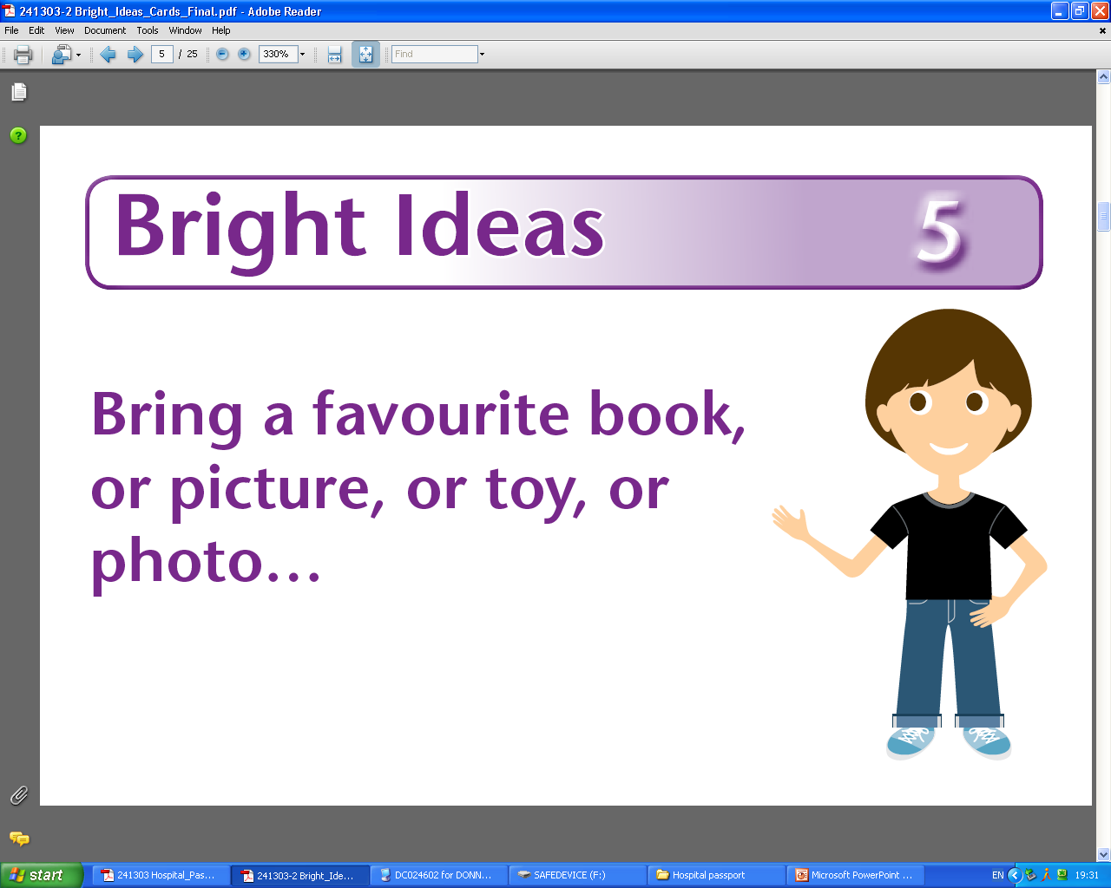
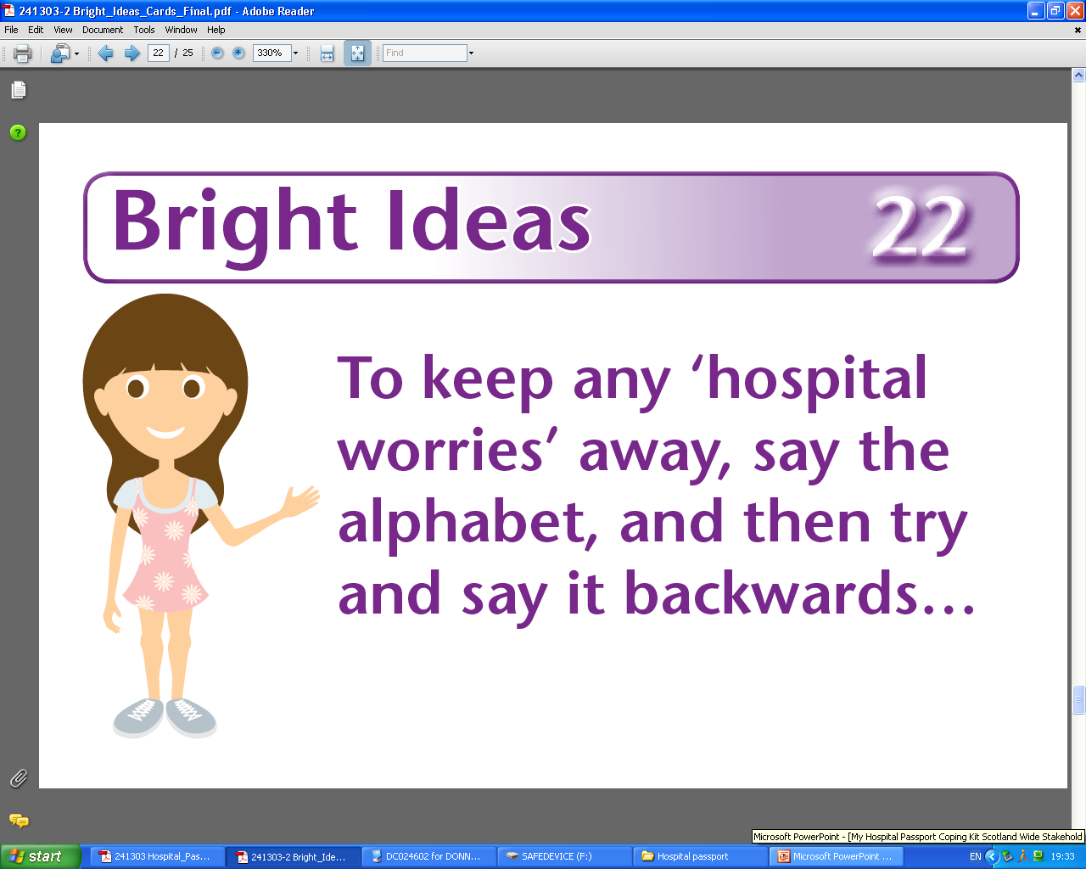

Hospital Passport
Notes:
Additional Notes:
So what is it?
Aimed at primary school aged children – would be appropriate for older children, they like the Bright Idea cards
Essentially would be helpful for any child going coming into hospital/clinic but obviously financial cost so target children who you think need additional ideas of support.
Posters up so children can also request if they want one.
The hospital Passport is made up of 3 main elements:
The hospital booklet itself
A set of 25 Bright Ideas Cards in a plastic stud fastener wallet
A Parent/Carer Information Sheet
How it Works:
Once the HP is given out to children, the idea is they go through the booklet with their parents/carers, who are in turn guided by the Parent/Carer information sheet, and fill in the sections most relevant for them by selecting and recording from a range of choices about what would help them with different aspects of hospital care. In addition, they are encouraged to choose which of the strategies in the Bright Idea Cards, based on preparation, choice, relaxation, and distraction techniques they feel they would most like to use to help them manage any hospital worries. The child then brings the booklet and their chosen Bright Idea Cards with them to each hospital or clinic visit.
The booklet also provides basic information to help prepare a child or signpost them to other professionals e.g play specialists who can give them more information and support. The packaging of the HP makes it easy to deliver/disseminate knowledge about these strategies in a really child centred way and as the HP is now beginning to be rolled out across all paediatric hospitals and wards in Scotland, it should ensure a continuity of practice and care to children coming into hospital which has not always been there before.
The “passport” Idea is that children take the passport with them around different areas of the hospital, and/or between hospitals to show staff. It also gives the message that hospital is something they come in and out of and that they go home afterwards.

Slide 12
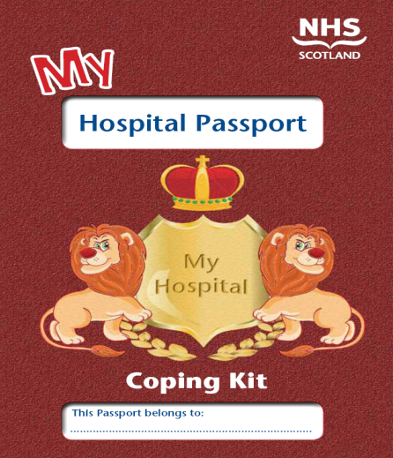
Hospital Passport
3 minute video showing the HP in action available at
https://vimeo.com/169549894
Notes:
Overall Aim:
Early Intervention / preventative tool to reduce anxiety and distress associated with hospital visits and procedures
Facilitate development of coping skills and strategies
Empower parents/carers and children/young people
Additional Aims
Training resource for staff
Bridges the gap between policy and practice
Improves communication of needs
Increases child's control in decision making process
Visual aid / concrete reminder of strategies
Funded by YCC and NES

Slide 13
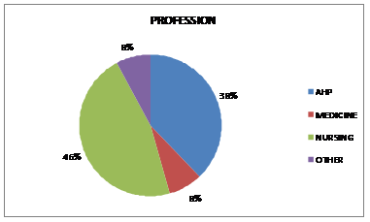
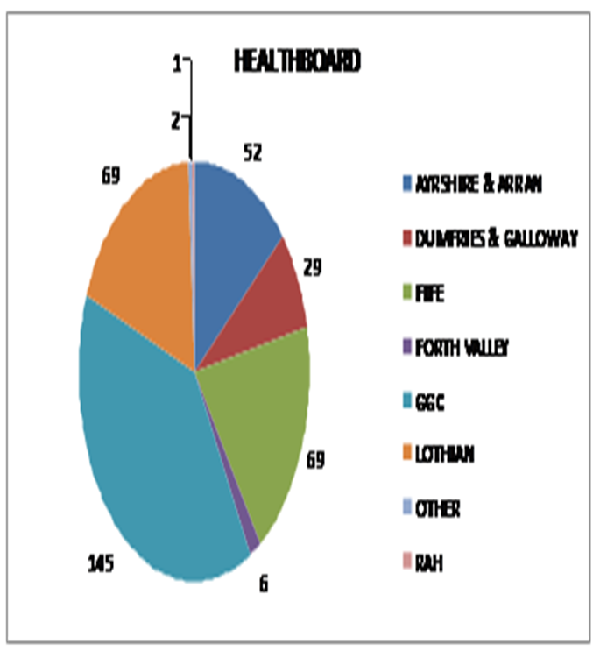
HP Training Roll Out Evaluation (Staff)
670 members of clinical staff across Scotland received HP training (April 2013-2015)
374 evaluation forms completed (return rate of 55.8%).
71% had been working in children’s health for 4 years or more
Only 31% had received any kind of training in reducing distress before HP training AND MOST OF THIS WAS THE NES TRAINING (only developed 3 years previously)

Slide 14
HP Training Roll Out Evaluation (Staff)
92% felt HP training had increased or refreshed knowledge of evidence based psychological strategies for managing distress
87% felt training had given them new ideas for using with children and young people.
90% agreed or strongly agreed that the HP Coping Kit would help prompt them to utilise psychological strategies in their clinical practice
90% felt it would help them to communicate more effectively with children and young people with regards to choices around what would support them with their medical care.
89% felt it would be useful in their daily practice.

Slide 15
Hospital Passport Roll Out Evaluation (Children/Parents/Carers)
Feedback forms (incorporated into Hospital passport pack to post back)
Replies received from 24 children and 34 parents
53% girls; 47% boys

Slide 16
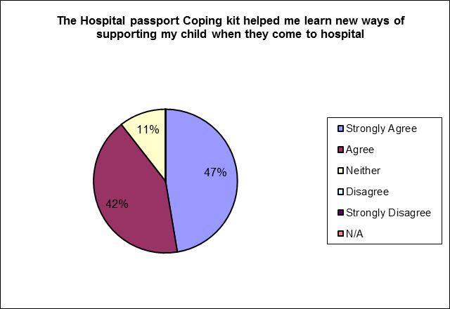
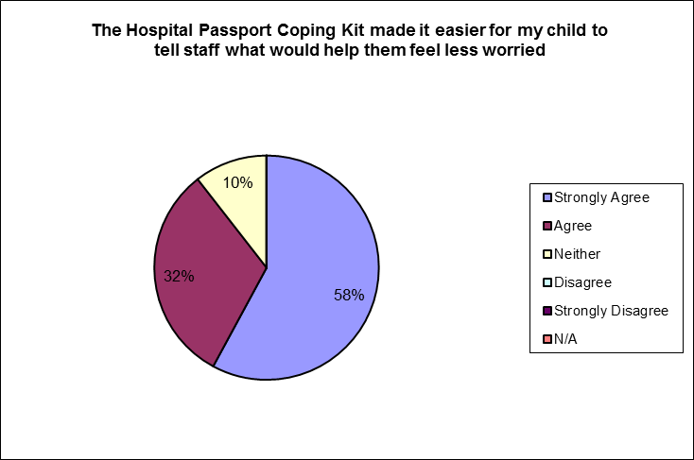
Feedback (Parents/Carers)

Slide 17
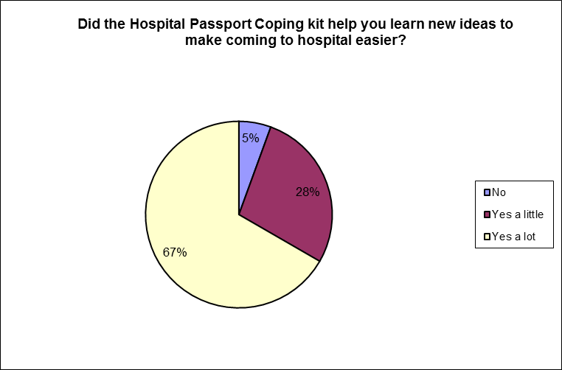
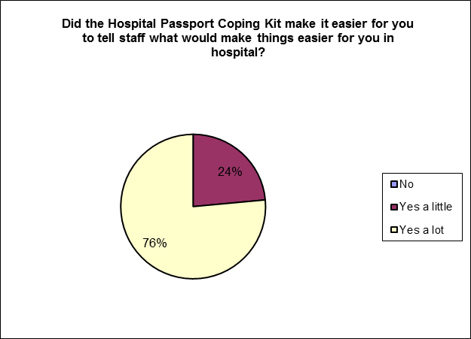
Feedback (Children)

Slide 18
Quotes from children, parents & staff
My son loved it . If he did not want to talk he gave a card then smiled.
(parent)
“It is good because it helps the doctors and nurses help me better” (child)
“It definitely helped me and my child talk more and made it easier to approach what is wrong with her and why she has to come to hospital” (parent)
“It can help stop you from being worried” (child)
“Gives the child a sense of achievement and encourages them to participate in procedures.” (staff)
“fantastic resource, puts the child back at the centre of decisions/choices (staff)
“Learning breathing techniques has helped my child get their peg changed. No tears and less stressful” (parent)
Notes:
Additional Notes:
80% of parents suggest the passport helped them discuss hospital visits with their children – found it was a really useful tool to open up communication about something some parents feel really anxious about suggesting as it allowed the discussion to have a positive focus around what would make the visit easier for the child and what choices the child would like to make – which they could indicate in their HP booklet and by their choice of Bright Idea Cards and which they could then share with staff.

Slide 19
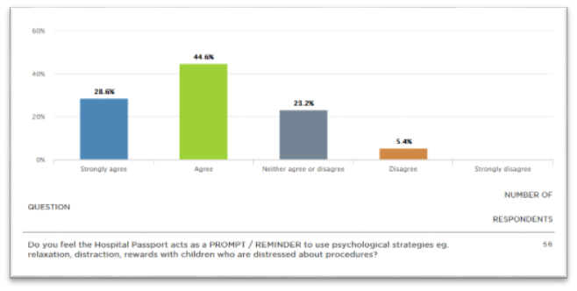
Hospital Passport 2 year evaluation

Slide 20
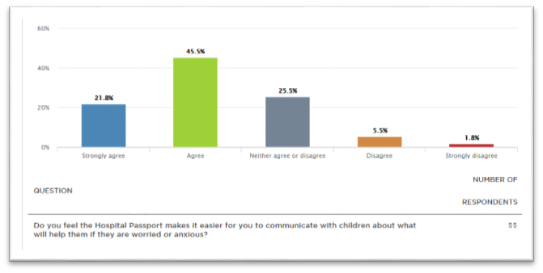
Hospital Passport 2 year evaluation

Slide 21
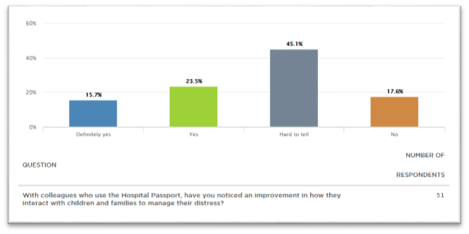
Hospital Passport 2 year evaluation

Slide 22
NES Psychosocial Intervention Training

Slide 23
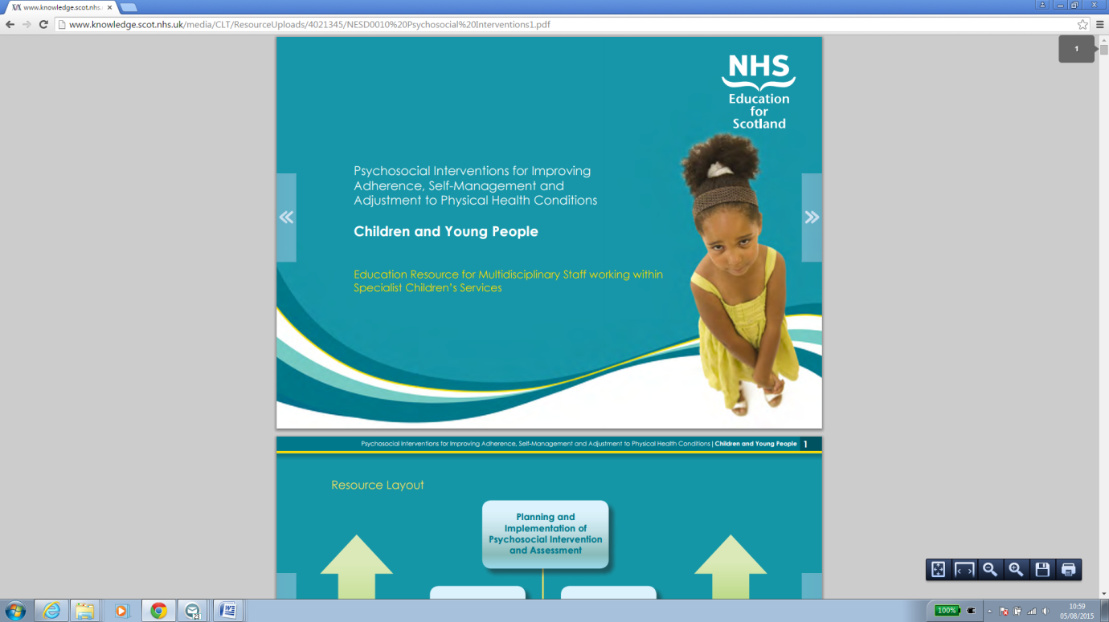
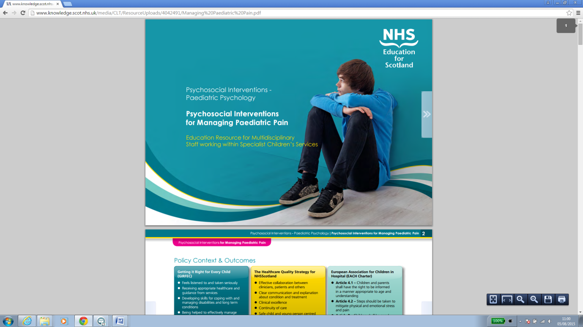

Skills Based Workshops
Psychosocial Interventions for Paediatric Healthcare Staff on:
Communication Skills (half day workshop)
Motivational Interviewing Approaches (half day workshop)
Reducing Distress (half day workshop
Promoting Positive Behaviour (half day workshop
Managing Paediatric Pain (half day workshop
Hospital Passport (30 minute presentation)
Visible Differences (one off)
Psychosocial Interventions for Neonatal Healthcare Staff on:
Identifying and Managing Distress in a Neonatal Unit (half day workshop)
Communication Skills (half day workshop)
Notes:
opportunity for some joint working with NES to develop specific training packages – if already done something but gap for that training – we could develop SLA with you – other examples if you want to work on developing new training / needs analysis e.g like with the oncology thing etc...

Slide 24
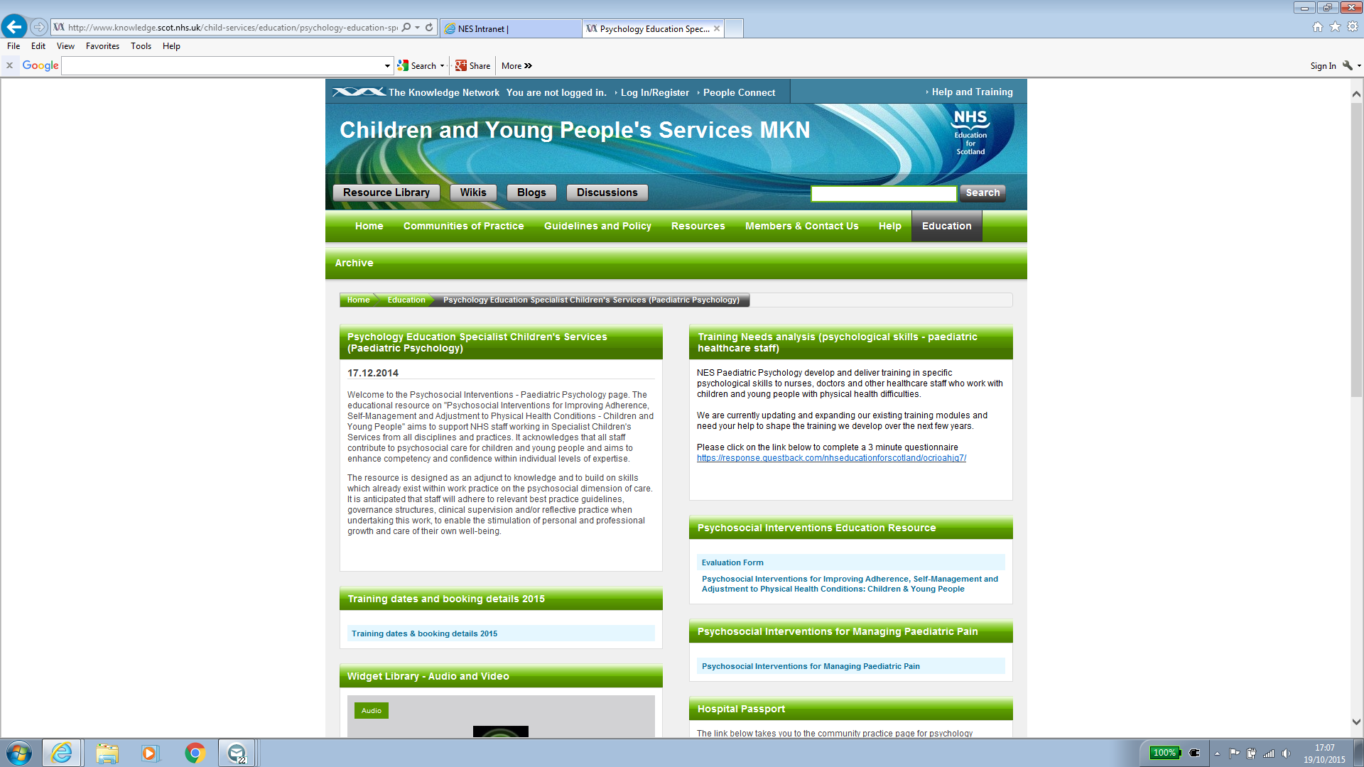
Online Resources
Available at http://www.knowledge.scot.nhs.uk/child-services/education/psychology-education-specialist-children's-services-(paediatric-psychology).aspx)
Psychosocial Interventions for Improving Adherence, Self-Management and Adjustment to Physical Health Conditions (interactive pdf education resource).
Psychosocial Interventions for Managing Paediatric Pain(interactive pdf education resource)
Hospital Passport (10 minute information video).
Downloadable audio recordings for relaxation (progressive muscle relaxation, controlled breathing, visualisation and mindfulness) for use with children, young people and parents.
Soon to be launched:
Psychosocial Interventions for Chronic Fatigue (e-learning resource).
Psychosocial Interventions for Procedural Distress (e-learning resource).
Psychosocial Interventions for Neonatal Healthcare Staff (e-learning resource).
Notes:
opportunity for some joint working with NES to develop specific training packages – if already done something but gap for that training – we could develop SLA with you – other examples if you want to work on developing new training / needs analysis e.g like with the oncology thing etc...
NES have the resources to support such developments etc.
Liz – to click in and show what’s available and bit of discussion re what they might find helpful.

Slide 25

400 places offered per year
% Trained by Profession over past 5 years

Slide 26
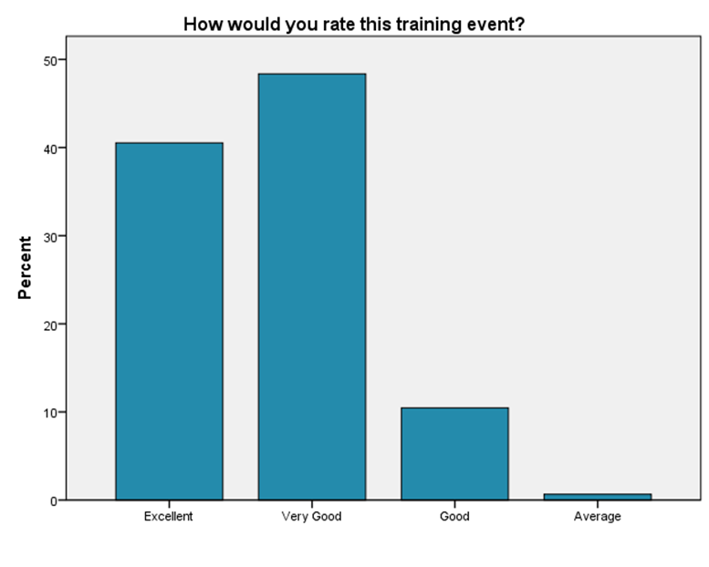
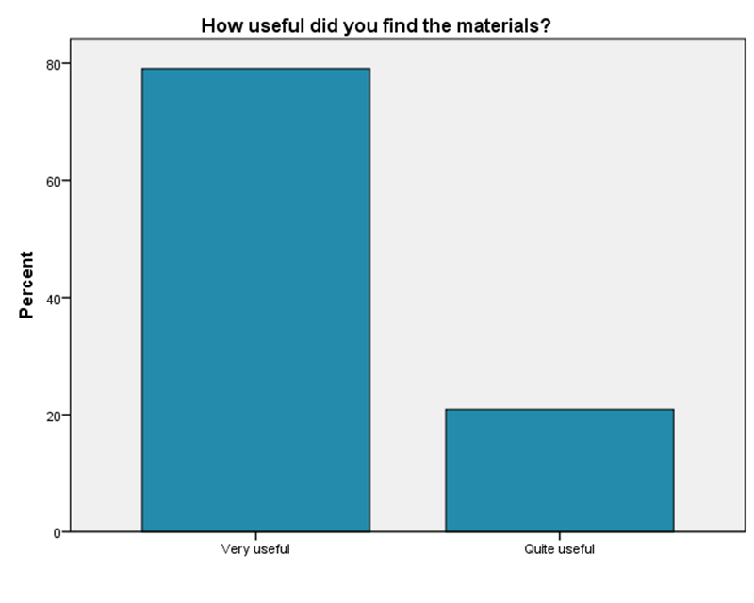
Evaluation
Post training T-test comparisons for knowledge and confidence ratings across all 5 modules demonstrate a significant increase in overall self-rated confidence and knowledge (consistent across all 5 years of delivery)
Post training, participants consistently respond that they would use the skills in their existing clinical practice
Post training, a consistently high rate of participants state that they would recommend the training to their colleagues

Slide 27
Quotes from staff (2015-2016 training)
Active listening and the other tools will allow me to focus on what matters to the client. (MI)
Materials are really useful. Looking forward to putting into practice. (Communication)
Thoroughly enjoyed this course. Very informative (RD)
Incredibly helpful! We need to have more of this information for secondary care, where pain...isn’t very holistic. V medical model focused. Please do more trainee teaching (Pain)
Went through everything thoroughly. Lots of new ideas and information (PPB)

Slide 28
Next steps … increasing the reach!
Ongoing roll out of NES Psychosocial Interventions training
Ongoing roll out of Hospital Passport resource to children and families
Promotion of useful websites/sources of information e.g WWCIH, Medikidz, Handsonscotland, Kidzhealth, Action for Children Scotland
About to launch
  E-learning resource on Procedural Distress (NES)
  Hospital Passport app

Slide 29

Thank you for listening
Other useful references
  PPN Invasive Procedures Guidelines (Paediatric Psychology Network, British Psychological Society, 2009)
  What Good Looks Like (Faculty of Children and Young People, British Psychological Society, 2015)
  janie.donnan@nes.scot.nhs.uk

